Slide 1
Rosalind Franklin
DNA

Slide 2
What you should know before you start
X-rays
We see things when light travels from an object, or reflects off it, into our eyes. Molecules are made up of lots of atoms bonded together. Molecules are too small to see with the our eyes, or even a microscope. But we can see them with x-rays so long as the molecules are set into a hard crystal.
DNA
If you look under a microscope, you’ll see that every bit of our bodies is made up of cells, like tiny bricks, that stack together to make our skin, our teeth, our hair – and everything inside us. Inside those cells is a molecule called DNA.
DNA stores information about how to make us: the colour and shape and placement of our skin, teeth, hair, and everything inside us. The shape of the DNA molecule is a double helix – a twisted ladder, like a wind spinner.
Slide 1

Slide 3
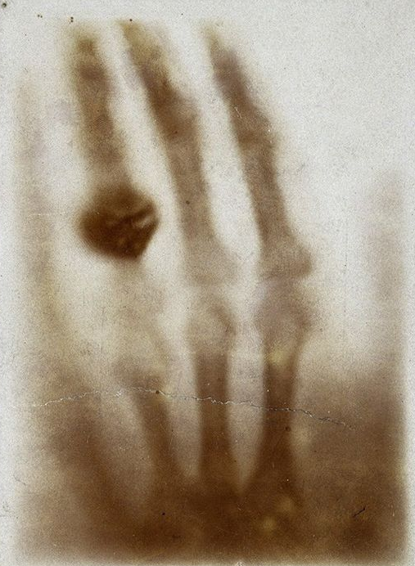
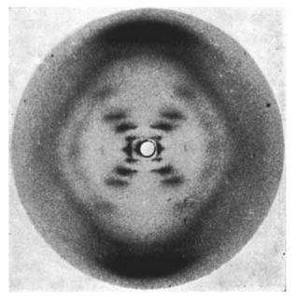
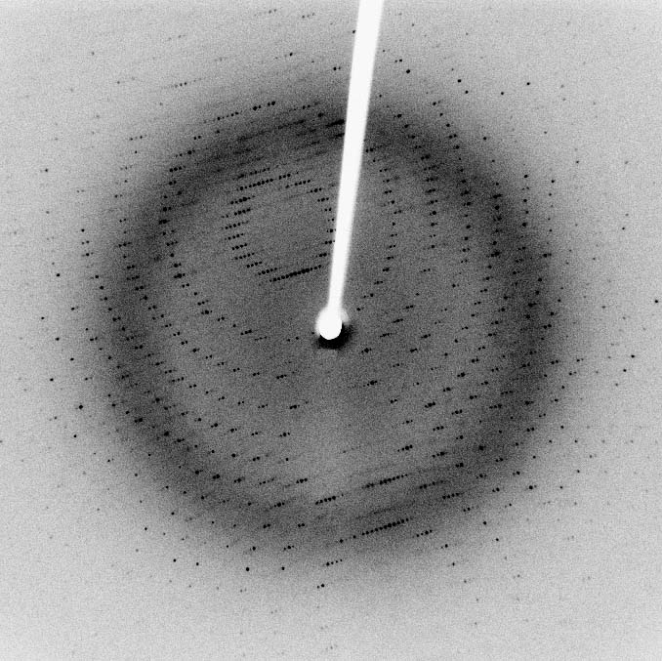
First medical X-ray
Photo 51
Protein scattering pattern
Notes:
Photo 51: https://en.wikipedia.org/wiki/File:Photo_51_x-ray_diffraction_image.jpg
First medical x-ray: https://commons.wikimedia.org/wiki/File:First_medical_X-ray_by_Wilhelm_R%C3%B6ntgen_of_his_wife_Anna_Bertha_Ludwig%27s_hand_-_18951222.jpg
Protein scattering pattern: https://en.wikipedia.org/wiki/X-ray_scattering_techniques#/media/File:X-ray_diffraction_pattern_3clpro.jpg

Slide 4
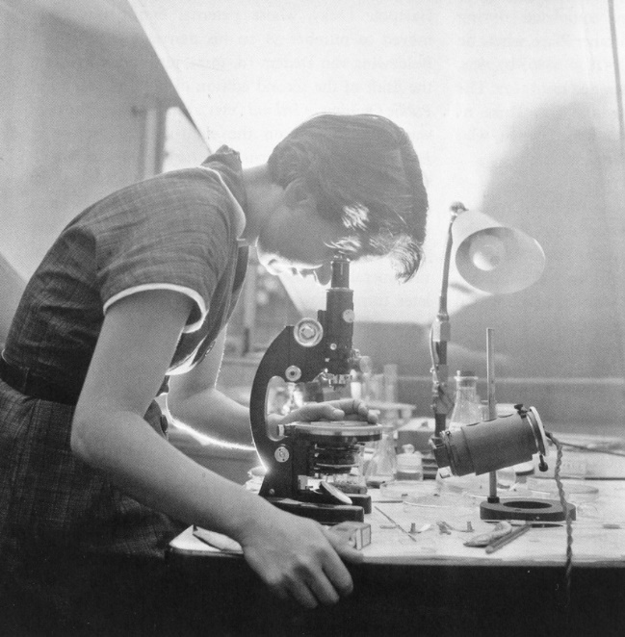
ROSALIND FRANKLIN
Slide 2
Notes:
https://en.wikipedia.org/wiki/File:Rosalind_Franklin_(1920-1958).jpg
https://www.rosalindfranklin.edu/symposiums/gender-bias/photograph-51/

Slide 5
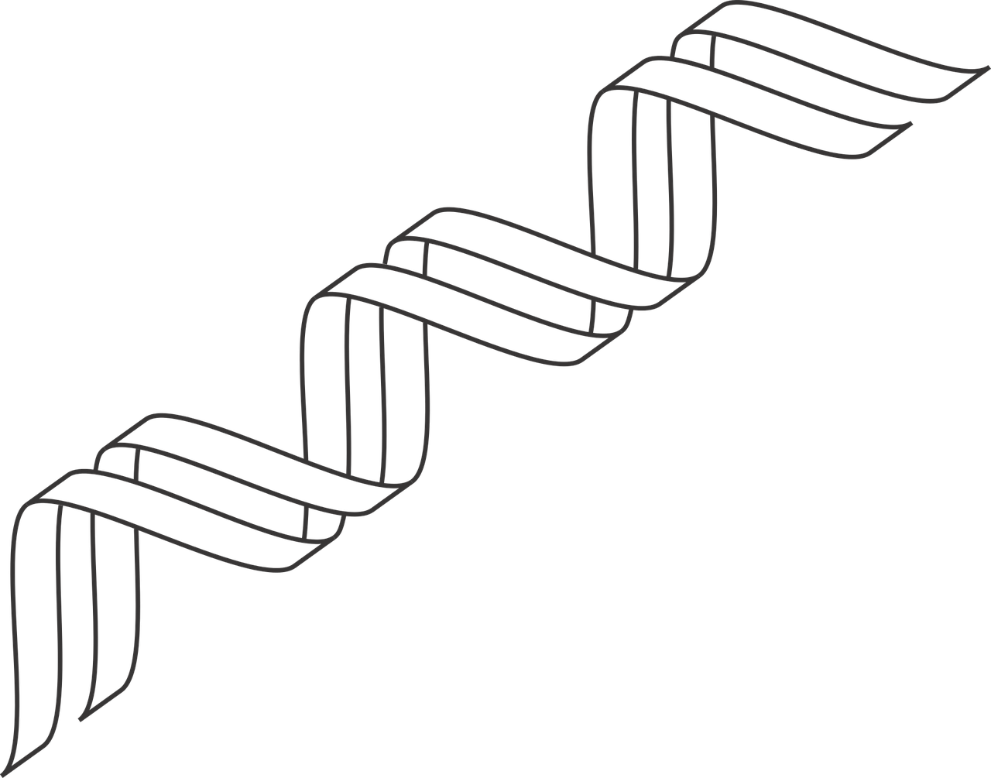
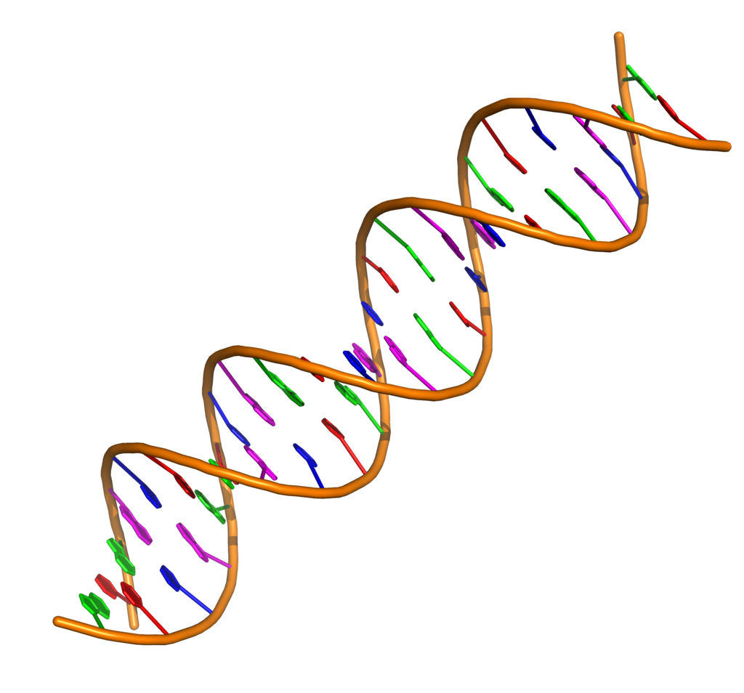
DNA
Double helix
Slide 3
Notes:
Double helix:
https://www.needpix.com/photo/1123115/gene-outline-dna-icon-dna-icon-double-helix-genetic-genetics
DNA: https://en.wikipedia.org/wiki/Nucleic_acid_double_helix#/media/File:Double_stranded_DNA_with_coloured_bases.png

Slide 6
Wind Spinner
Slide 4
Notes:
Wind spinner: https://www.windandweather.com/p/56443?aff=7593 (not a free image)

Slide 7
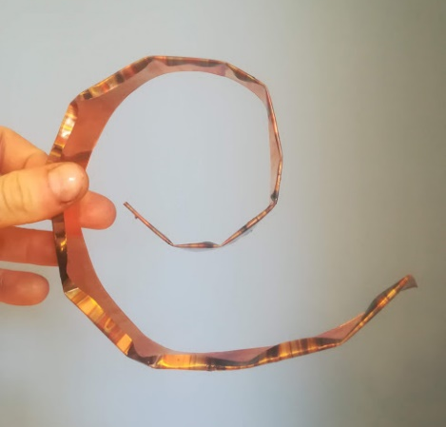
How to make a wind spinner
Slide 5

Slide 8
Slide 6

Slide 9
Photo Credits: Photo Rosalind Franklin at work in a London Laboratory –Museum of London/Henry Grant Collection
Wind Spinner – windandweather.com
Double helix – needpix.com Other images – Wikipedia – public domain
© HMDT Music 2020

